Slide 1
Bigram Language model with Transfer learning GPT-2
Azadeh Kooshesh Second brain 2023

Slide 2
What is Bigram model
A bigram model is a type of probabilistic language model that is based on the occurrence and co-occurrence of pairs of adjacent words (or tokens) in a given text or corpus. It's a simple way of modeling the probability of a word given its preceding word.
In a bigram model, the probability of a word depends only on the previous word. The model assumes that the occurrence of a word is independent of all other words in the text, given its immediate predecessor. Mathematically, this can be expressed as:
[ P(w_n | w_{n-1}, w_{n-2}, \ldots, w_1) = P(w_n | w_{n-1}) ]
Here, \(w_n\) represents the nth word in the sequence, and \(w_{n-1}\) represents the (n-1)th word.
Bigram models are often used in natural language processing (NLP) tasks, such as text generation, machine translation, and speech recognition. They provide a simple way to capture some of the sequential dependencies present in language, although they are limited compared to more complex models like” trigram” or n-gram models that consider longer sequences of words.

Slide 3
What is Bigram model reference
https://web.stanford.edu/~jurafsky/slp3/3.pdf
https://www.educative.io/answers/what-is-a-bigram-language-model
https://datachild.net/machinelearning/bigram-language-model-python

Slide 4
TL in LLM
A quick overview of transfer learning in LLM…

Slide 5
What is transfer learning
Transfer learning in the context of language models, particularly Large Language Models (LLMs) like GPT (Generative Pre-trained Transformer), refers to the practice of pre-training a language model on a large dataset and then fine-tuning it on a smaller, task-specific dataset. The idea is to leverage the knowledge gained during pre-training on a broad range of language tasks, and then adapt or transfer that knowledge to a specific task or domain.
Here's a general outline of how transfer learning works for LLMs:
Pre-training: A language model is pre-trained on a massive corpus of text data. During this pre-training phase, the model learns to predict the next word in a sentence or fill in gaps in sentences, gaining a broad understanding of language patterns and contextual relationships.
Fine-tuning:After pre-training, the model is fine-tuned on a smaller dataset that is specific to a particular task or domain. This dataset might be annotated for a specific task, such as sentiment analysis, named entity recognition, question answering, or others.

Slide 6
What is transfer learning
Transfer learning has several advantages:
Reduced Data Requirements:Since the model has already learned a lot from a large dataset during pre-training, it requires less labeled data for fine-tuning.
Faster Training: Training a model from scratch on a specific task can be time-consuming and resource-intensive. Transfer learning allows leveraging pre-trained parameters, making the fine-tuning process faster.
Improved Performance: Pre-training on a diverse dataset helps the model capture general language patterns, which can contribute to better performance on downstream tasks.
For example, OpenAI's GPT models are often pre-trained on a massive amount of internet text and can then be fine-tuned on specific datasets for tasks like text completion, translation, summarization, and more.
Transfer learning has become a standard approach in natural language processing and machine learning in general, as it allows models to benefit from the knowledge gained across a wide range of tasks and domains.

Slide 7
—Address them
https://ieeexplore.ieee.org/stamp/stamp.jsp?tp=&arnumber=10196443
https://arxiv.org/pdf/2307.06435.pdf
https://livevox.com/understanding-transfer-learning-in-large-language-models-and-how-to-use-it-for-contact-center-efficiency-blog/#gref
https://medium.com/@andrew_johnson_4/transfer-learning-in-large-language-models-llms-a-comprehensive-guide-6b4a9a9d8cea
https://spotintelligence.com/2023/03/28/transfer-learning-large-language-models/

Slide 8
—Code code 001
Now I will test the TL in Andrej Karpathy’s Bigram Model

Slide 9
Introduction
This technical documentation describes a PyTorch implementation of a Bigram Language Model with Transfer Learning, leveraging a pre-trained GPT-2 model. The model is designed to predict the next token in a sequence given a context of previous tokens. The code utilizes transfer learning to initialize the model with the knowledge encoded in the pre-trained GPT-2 model, enhancing its performance on the specific task at hand.

Slide 10
Workflow
01
Set up Hyperparameters
04
Training and Evaluation
02
Data Loading and Preprocessing
05
Text Generation Example
03
Model Components and Transfer Learning
06
Monitoring

Slide 11
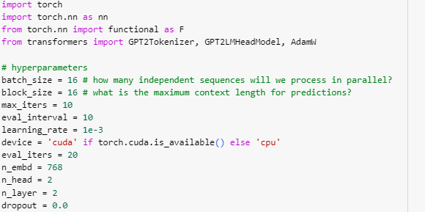
01

Slide 12
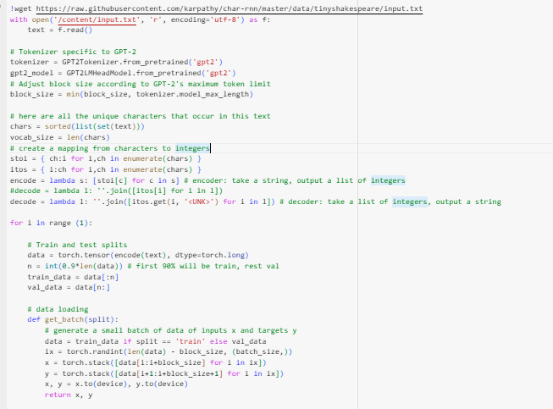
02

Slide 13
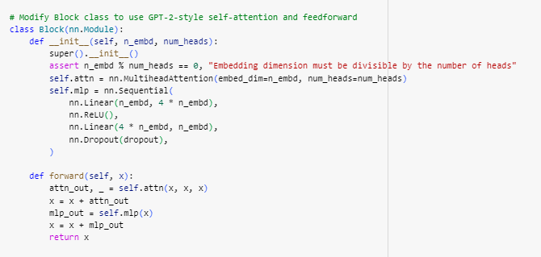
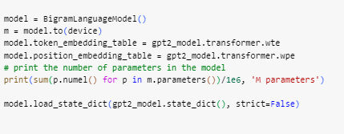
03

Slide 14
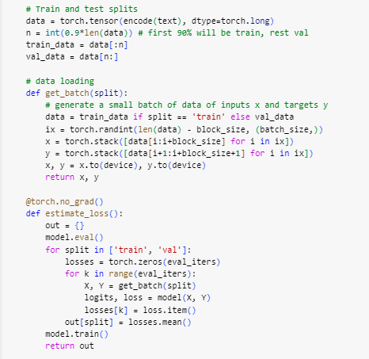
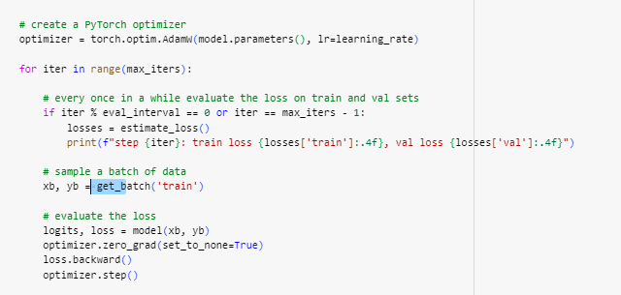
04

Slide 15
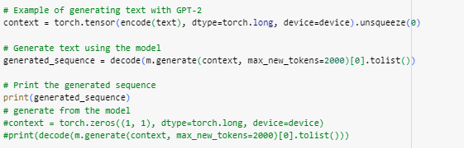
05

Slide 16
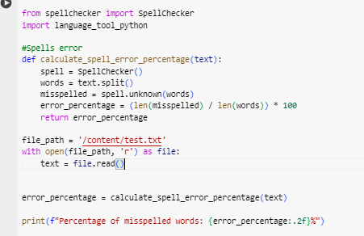
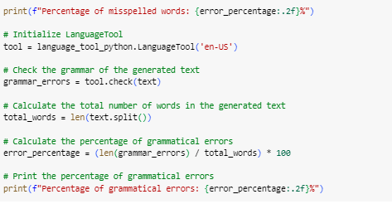
06

Slide 17
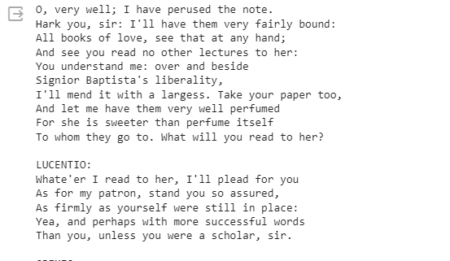
Result

Slide 18
Model Architecture
Training with Transfer Learning
The Bigram Language Model incorporates token and position embeddings, followed by GPT-2-style self-attention blocks. The pre-trained GPT-2 model is used for initializing the token and position embeddings, enhancing the model's performance through transfer learning.
Transfer learning is implemented by initializing the Bigram Language Model with the weights learned by the pre-trained GPT-2 model. This allows the model to leverage the knowledge captured during pre-training and fine-tune its parameters for the specific language modeling task.

